Slide 1
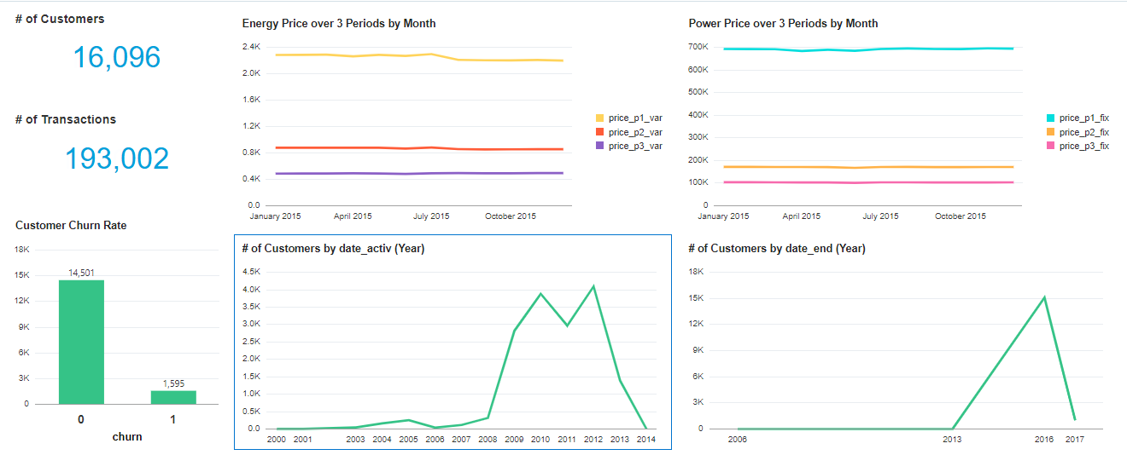
From the visualizations below, we can see that the prices of energy and power reduces over the periods. Also, there was an increase in Customers in 2009, but then more Customers had their contracts ending in 2016. Also, about 10% of the Customers have churned.

Slide 2
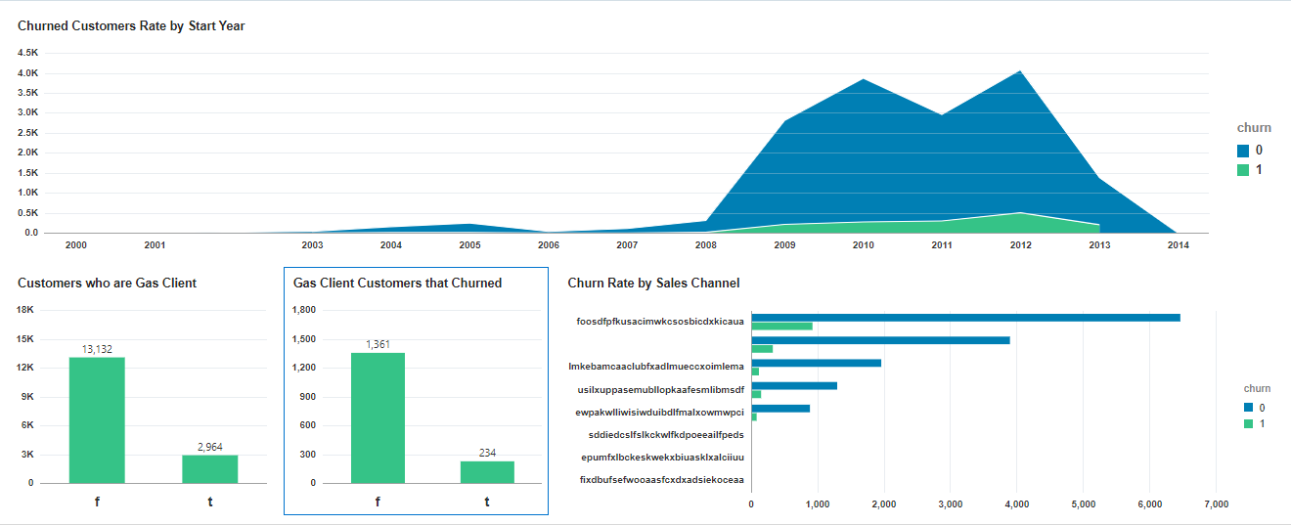
From the visulas below, it is clear that churning became serious with Customers who joined between 2009 and 2013. Which are the years when a lot of Customers also joined. Also, looking at Customers who are Gas Clients, it shows that churning doesn’t necessarily depend on being a Gas client.

Slide 3
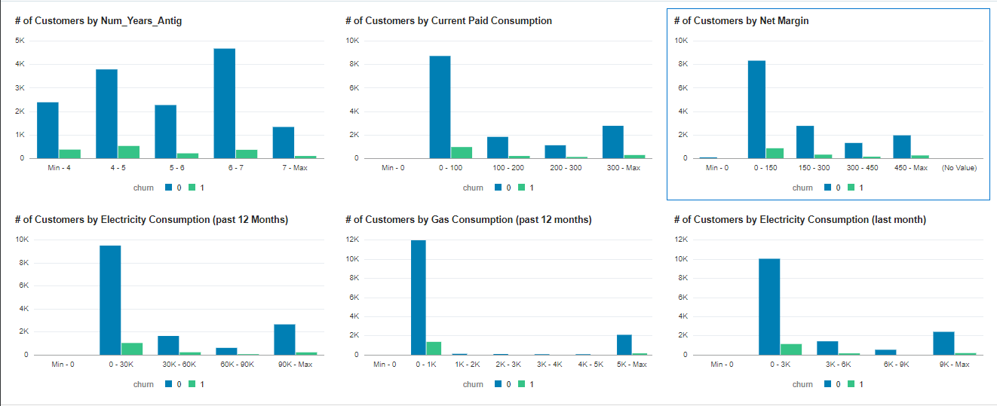
Customers churn varies across number of years spent. Although Customers from 4-5 years churn more than other groups. Most of the churned Customers actually have low Current paid consumption and Net Margin. Also, most churned Customers have low Electricity Consumption and Gas Consumption for the last 12 months. Customer churning is not so dependent on the prices, as it varies accross.

